Slide 1
Comparative Case Studies
Doing Political Research

Slide 2
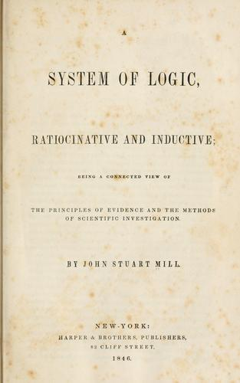
History of Comparative Methods
Comparison is fundamental to political research
Aristotle: comparison of 158 Greek city-state constitutions
Mill’s Methods: Logically inferring causation from necessary and sufficient conditions

Slide 3
What is a Case?
An instance of a political system, event or phenomenon in a specified place and/or at a certain time
For example:
British parliamentary elections in 2001, 2005, 2009
Parliamentary elections in UK 2001, France 2002, Germany 2002
IMF bailouts: UK 1976, Greece 1978, Mexico 1982
Electoral systems: FPTP in UK, US; PR in Spain, Portugal
Coups: Nigeria 1993, Thailand 2014, Burkina Faso 2022
Failed coups: Burkina Faso 2016, Turkey 2015
What is the universe of cases?
To what extent are your cases representative of the universe?

Slide 4
Necessary and Sufficient Conditions
Necessary conditions:
Without this condition (or set of conditions), the outcome cannot occur
For example, Barrington Moore: “No middle class, no democracy”
Sufficient conditions
With this condition (or set of conditions), the outcome will occur
For example, perceived fiscal irresponsibility is sufficient for bond market instability

Slide 5
Comparative Research Designs
Most similar systems
Most different systems
Most similar/most different systems

Slide 6
Most Similar Systems Designs
Similar cases, different outcome

Slide 7
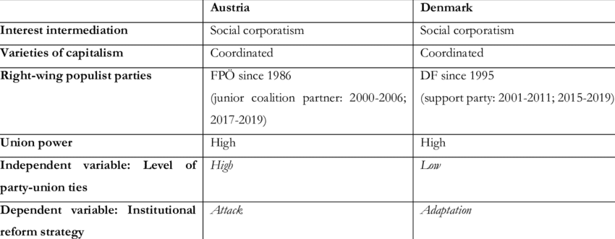
Klitgaard and Rathgeb, “Attack or Adapt? The Institutional Politics of Populist Radical Right Parties”

Slide 8
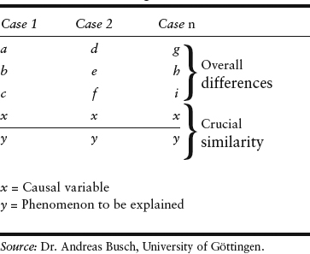
Most Different Systems Design
Different cases, same outcome

Slide 9
Gonzalez, “Reforming to Avoid Reform: Strategic Policy Substitution and the Reform Gap in Policing”

Slide 10
Most Similar/Most Different Systems
Combination of the two comparative methods
Each case examined has at least one other which is similar in most aspects except in the outcome and the explanatory variable…
and another which is different in most respects except in the outcome and the explanatory variable

Slide 11
Schneider, “Responding to fiscal stress: Fiscal institutions and fiscal adjustment in four Brazilian states”
 | Rio Grande do Sul | Parana | Pernambuco | Bahia
Region | South | South | Northeast | Northeast
Economy | Rich, industrialised | Rich, industrialised | Poor, primary commodities | Poor, primary commodities
Budgeting | Democratic | Autocratic | Democratic | Autocratic
Response to fiscal stress | Delayed, market-governing | Swift, market-oriented | Delayed, market-governing | Swift, market-oriented

Slide 12
How Do We Research Cases?
Comparative case analysis involves other methods of data collection and analysis
Historical cases: archival research, secondary literature
Contemporary cases: interviews, documentary research, statistics, surveys, secondary literature
Theory guides what we look for in the case ie potential necessary and sufficient conditions
But examining cases can help to refine theory too

Slide 13
Case Selection
Variation in the dependent variable is vital
Comparative case study designs are sensitive to case selection
Would adding an extra case alter your conclusions?
Be clear about the universe of cases
How representative are the cases you choose?
Theories generated by comparing certain cases should be tested by comparing other cases
But this is not how research often progresses

Slide 14
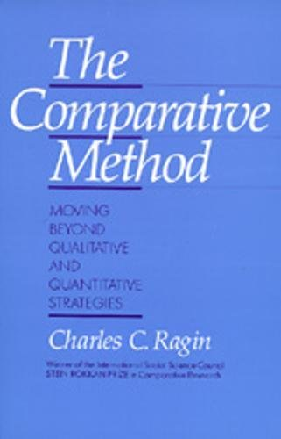
Qualitative Comparative Analysis
Data analysis based on set theory: finding configurations of circumstances which lead to a certain outcome
Extension of most similar/most different systems research design to a larger number of cases
Based on necessary and sufficient conditions
Embrace of equifinality
Example: Bank et al, "Long-term monarchical survival in the Middle East: a configurational comparison, 1945–2012"

Slide 16
Conclusion
Comparative case studies are a popular and powerful method
Universe of cases and case selection
Theory-generating or theory-testing?
Deterministic vs probabilistic causation
Potential to combine with other methods (but remember Mahoney and Goertz’s ‘two cultures’)

